Slide 1
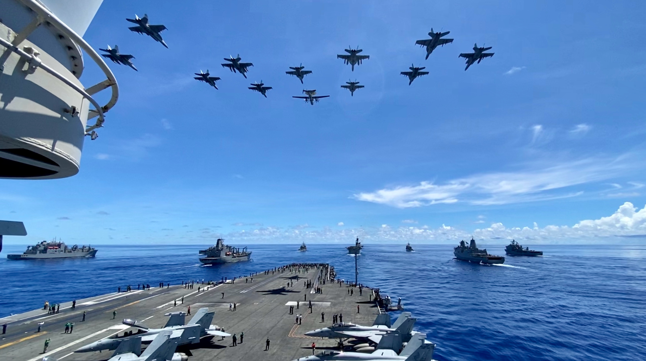
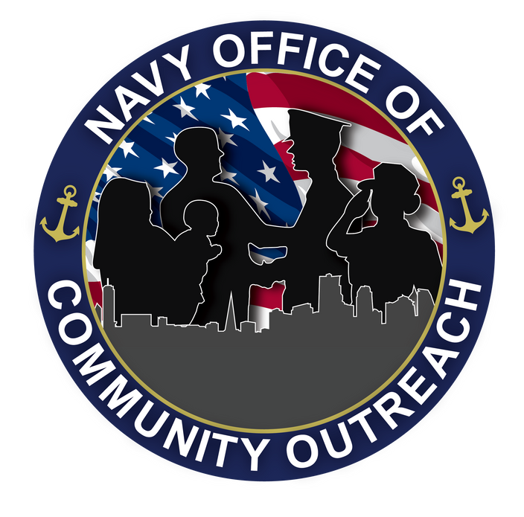
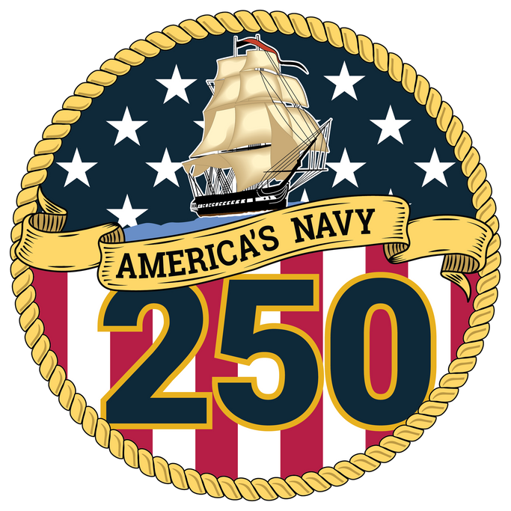

Notes:
200925-N-PL200-0001 PHILIPPINE SEA (Sept. 25, 2020) From left, USNS Sacagawea (T-AKE 2), USS Germantown (LSD 42), USNS John Ericsson (T-AO 194), USS Antietam (CG 54), USS Ronald Reagan (CVN 76), USS America (LHA 6), USS Shiloh (CG 67), USS New Orleans (LPD 18), and USS Comstock (LSD 45) steam in formation while E/A-18G Growlers, FA-18E Super Hornets and an E-2D Hawkeye from Carrier Air Wing (CVW) 5 fly over in support of Valiant Shield 2020. Valiant Shield is a U.S. only, biennial field training exercise (FTX) with a focus on integration of joint training in a blue-water environment among U.S. forces. This training enables real-world proficiency in sustaining joint forces through detecting, locating, tracking and engaging units at sea, in the air, on land and in cyberspace in response to a range of mission areas. (U.S. Navy photo by Lt. Lauren Chatmas)

Slide 2
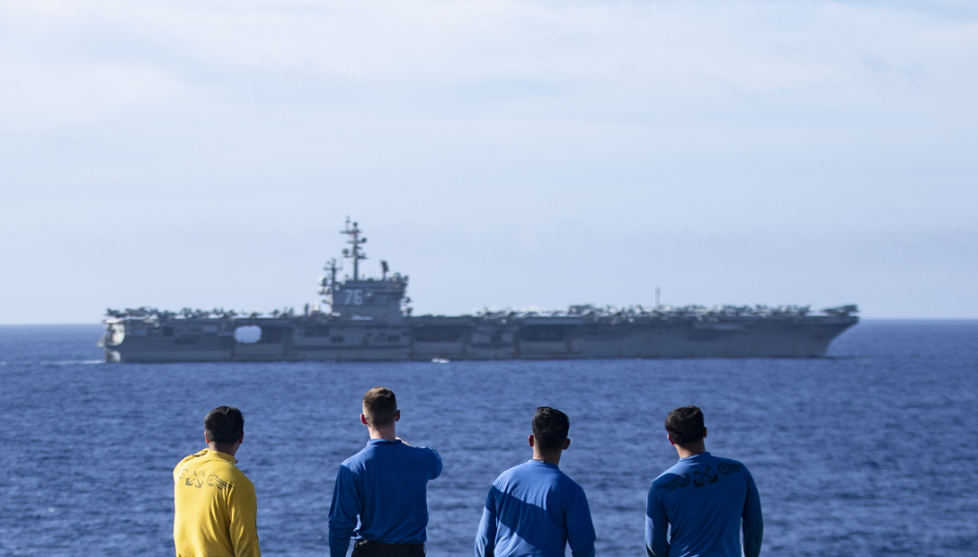
WHY WE SERVE
The United States is a maritime nation, and the U.S. Navy protects America at sea. Alongside our allies and partners,
we defend freedom, preserve economic prosperity, and keep the seas open and free.
Our nation is engaged in long-term competition. To defend American interests around the globe, the U.S. Navy must remain prepared to execute our timeless role, as directed by Congress and the President.
Notes:
220612-N-IL330-1219 (PHILIPPINE SEA) – Sailors watch as the aircraft carrier USS Ronald Reagan (CVN 76) sails alongside amphibious assault carrier USS Tripoli (LHA 7) prior to a photo exercise for Valiant Shield 2022, June 12, 2022. Exercises like VS 22 allow forces across the Indo-Pacific the opportunity to integrate Navy, Marine Corps, Army, Airforce, Space Force, to train in precise, lethal, and overwhelming multi access, multi domain, effects that demonstrate the strength and versatility of the joint force. Tripoli is operating in the U.S. 7th Fleet area of operations to enhance interoperability with allies and partners and serve as a ready response force to defend peace and maintain stability in the Indo-Pacific region. (U.S. Navy photo by Mass Communication Specialist Seaman Austyn Riley)

Slide 3

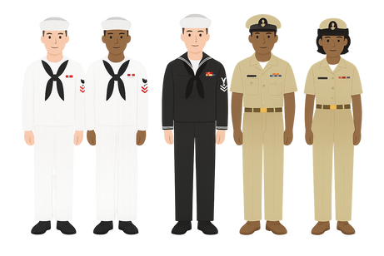


WHY WE SERVE
The United States is a maritime nation, and the U.S. Navy protects America at sea. Alongside our allies and partners,
we defend freedom, preserve economic prosperity, and keep the seas open and free.
Our nation is engaged in long-term competition. To defend American interests around the globe, the U.S. Navy must remain prepared to execute our timeless role, as directed by Congress and the President.
340+
24
7
/
7
FLEETS
THOUSAND
Sailors protect us
every day
Defending America
Are ready around
the globe

Slide 4



WHY WE SERVE
The United States is a maritime nation, and the U.S. Navy protects America at sea. Alongside our allies and partners,
we defend freedom, preserve economic prosperity, and keep the seas open and free.
Our nation is engaged in long-term competition. To defend American interests around the globe, the U.S. Navy must remain prepared to execute our timeless role, as directed by Congress and the President.
90%
95%
> $2 TRILLION
Of global trade occurs via oceans
Of goods pass through key waters
Of data moves along undersea cables

Slide 5

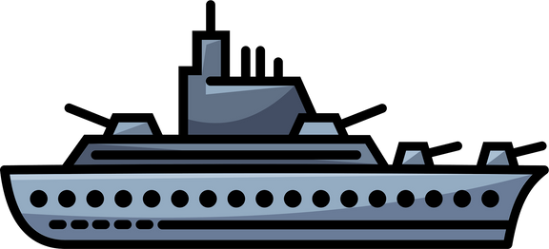

WHY WE SERVE
The United States is a maritime nation, and the U.S. Navy protects America at sea. Alongside our allies and partners,
we defend freedom, preserve economic prosperity, and keep the seas open and free.
Our nation is engaged in long-term competition. To defend American interests around the globe, the U.S. Navy must remain prepared to execute our timeless role, as directed by Congress and the President.
70%
60+
FREEDOM OF NAVIGATION
ALLIED NAVIES
Of Earth is covered
in water
Keeps sea lanes open
Train and operate with the U.S. Navy

Slide 6
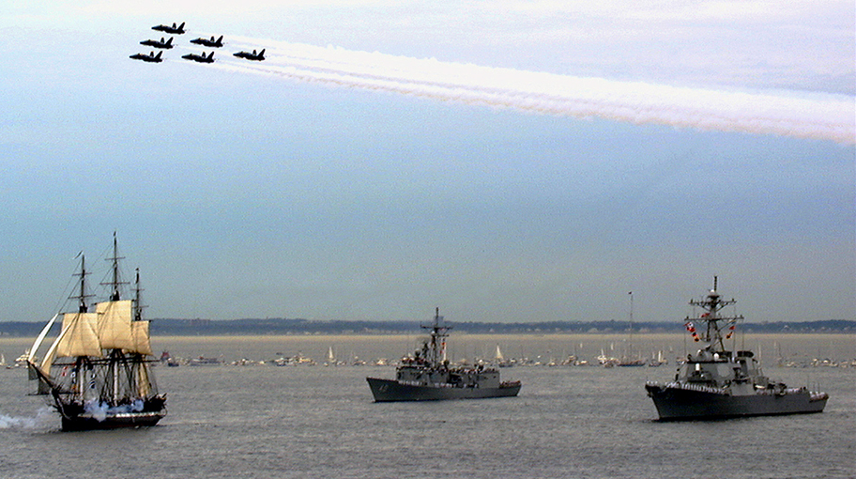


NATION 250
THE AMERICAN SPIRIT: FORGED AT SEA, SUSTAINED THROUGH GENERATIONS, DOMINANT ALWAYS
SECURITY
SERVICE
America is a maritime Nation and the United States Navy protects freedom and preserves prosperity
At the heart of America’s story is the sea—and the American Sailor that safeguards our freedom
Notes:
For 250 years, our Navy has stood the watch—constant, unabated in mission, faithfully present in crisis, and resolute in defending American interests worldwide.
For the next 250 years, our Navy will remain forward, ready, and lethal—protecting the homeland, safeguarding global commerce, and delivering peace through strength alongside our allies.
From seabed to space, the Navy projects power for peace—driven by warfighters who are prepared, lethal, and ready to win.
At 12:30 on July 21, 1997, USS Constitution began to fire a 21-gun salute as she sailed for the first time, under her own power, in 116 years. She was escorted by the frigate USS Halyburton (FFG 40) (center) and the destroyer USS Ramage (DDG 61) (right), while the Navy’s “Blue Angels” Flight Demonstration Squadron passed overhead. [U.S. Navy Photo/ Journalist 2nd Class Todd Stevens]

Slide 7






Navy and Marine Corps Across the Globe
295
31%
Deployed (92 of 295)
26%
43
33
43,000+
Underway (76 of 295)
Sailors Deployed
Deployed Underway
32,000+
Marines Deployed
Total Battle Force Ships
Local Operations
6TH FLT (EUCOM)
10TH FLT (CYBERCOM)
3RD FLT (INDOPACOM)
I MEF
2ND FLT (NORTHCOM)
II MEF
III MEF
5TH FLT (CENTCOM)
7TH FLT (INDOPACOM)
4TH FLT
(SOUTHCOM)
CARL VINSON (CSG)
GEORGE WASHINGTON (CVN)
AMERICA (LHD)
HARRY S. TRUMAN (CSG)
Forward deployed naval forces preserving global freedom
Notes:
Current 19 March 2025. This slide is meant to represent a snapshot in time.

Slide 8
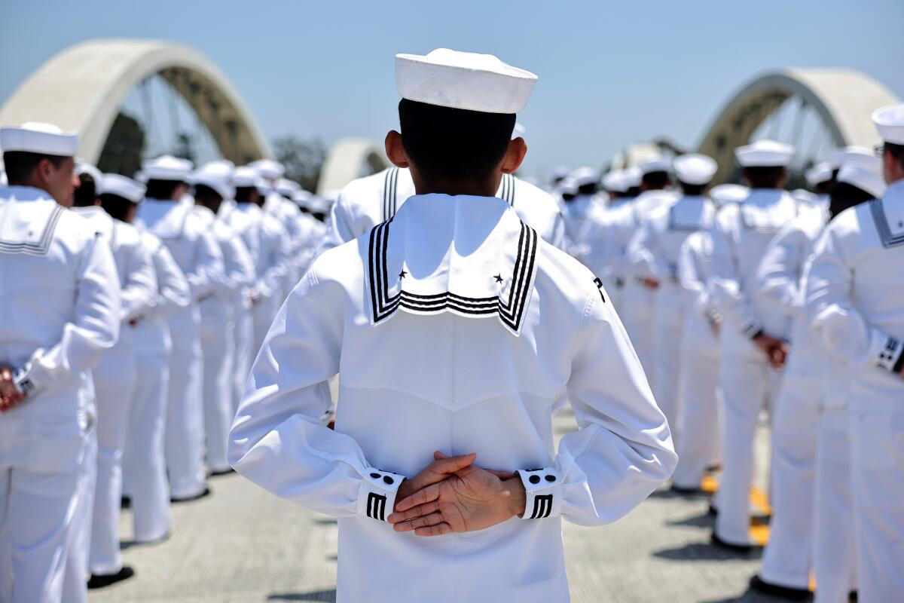
OUR WARFIGHTERS
The U.S. Navy is comprised of highly trained professionals operating across sea, air, land, undersea, and cyber domains.
Active, Reserve, and civilian personnel work together as one force to keep the Navy ready and capable around the world.
340,000
Active
200,000
Civilian
58,000
Reserve

Slide 9
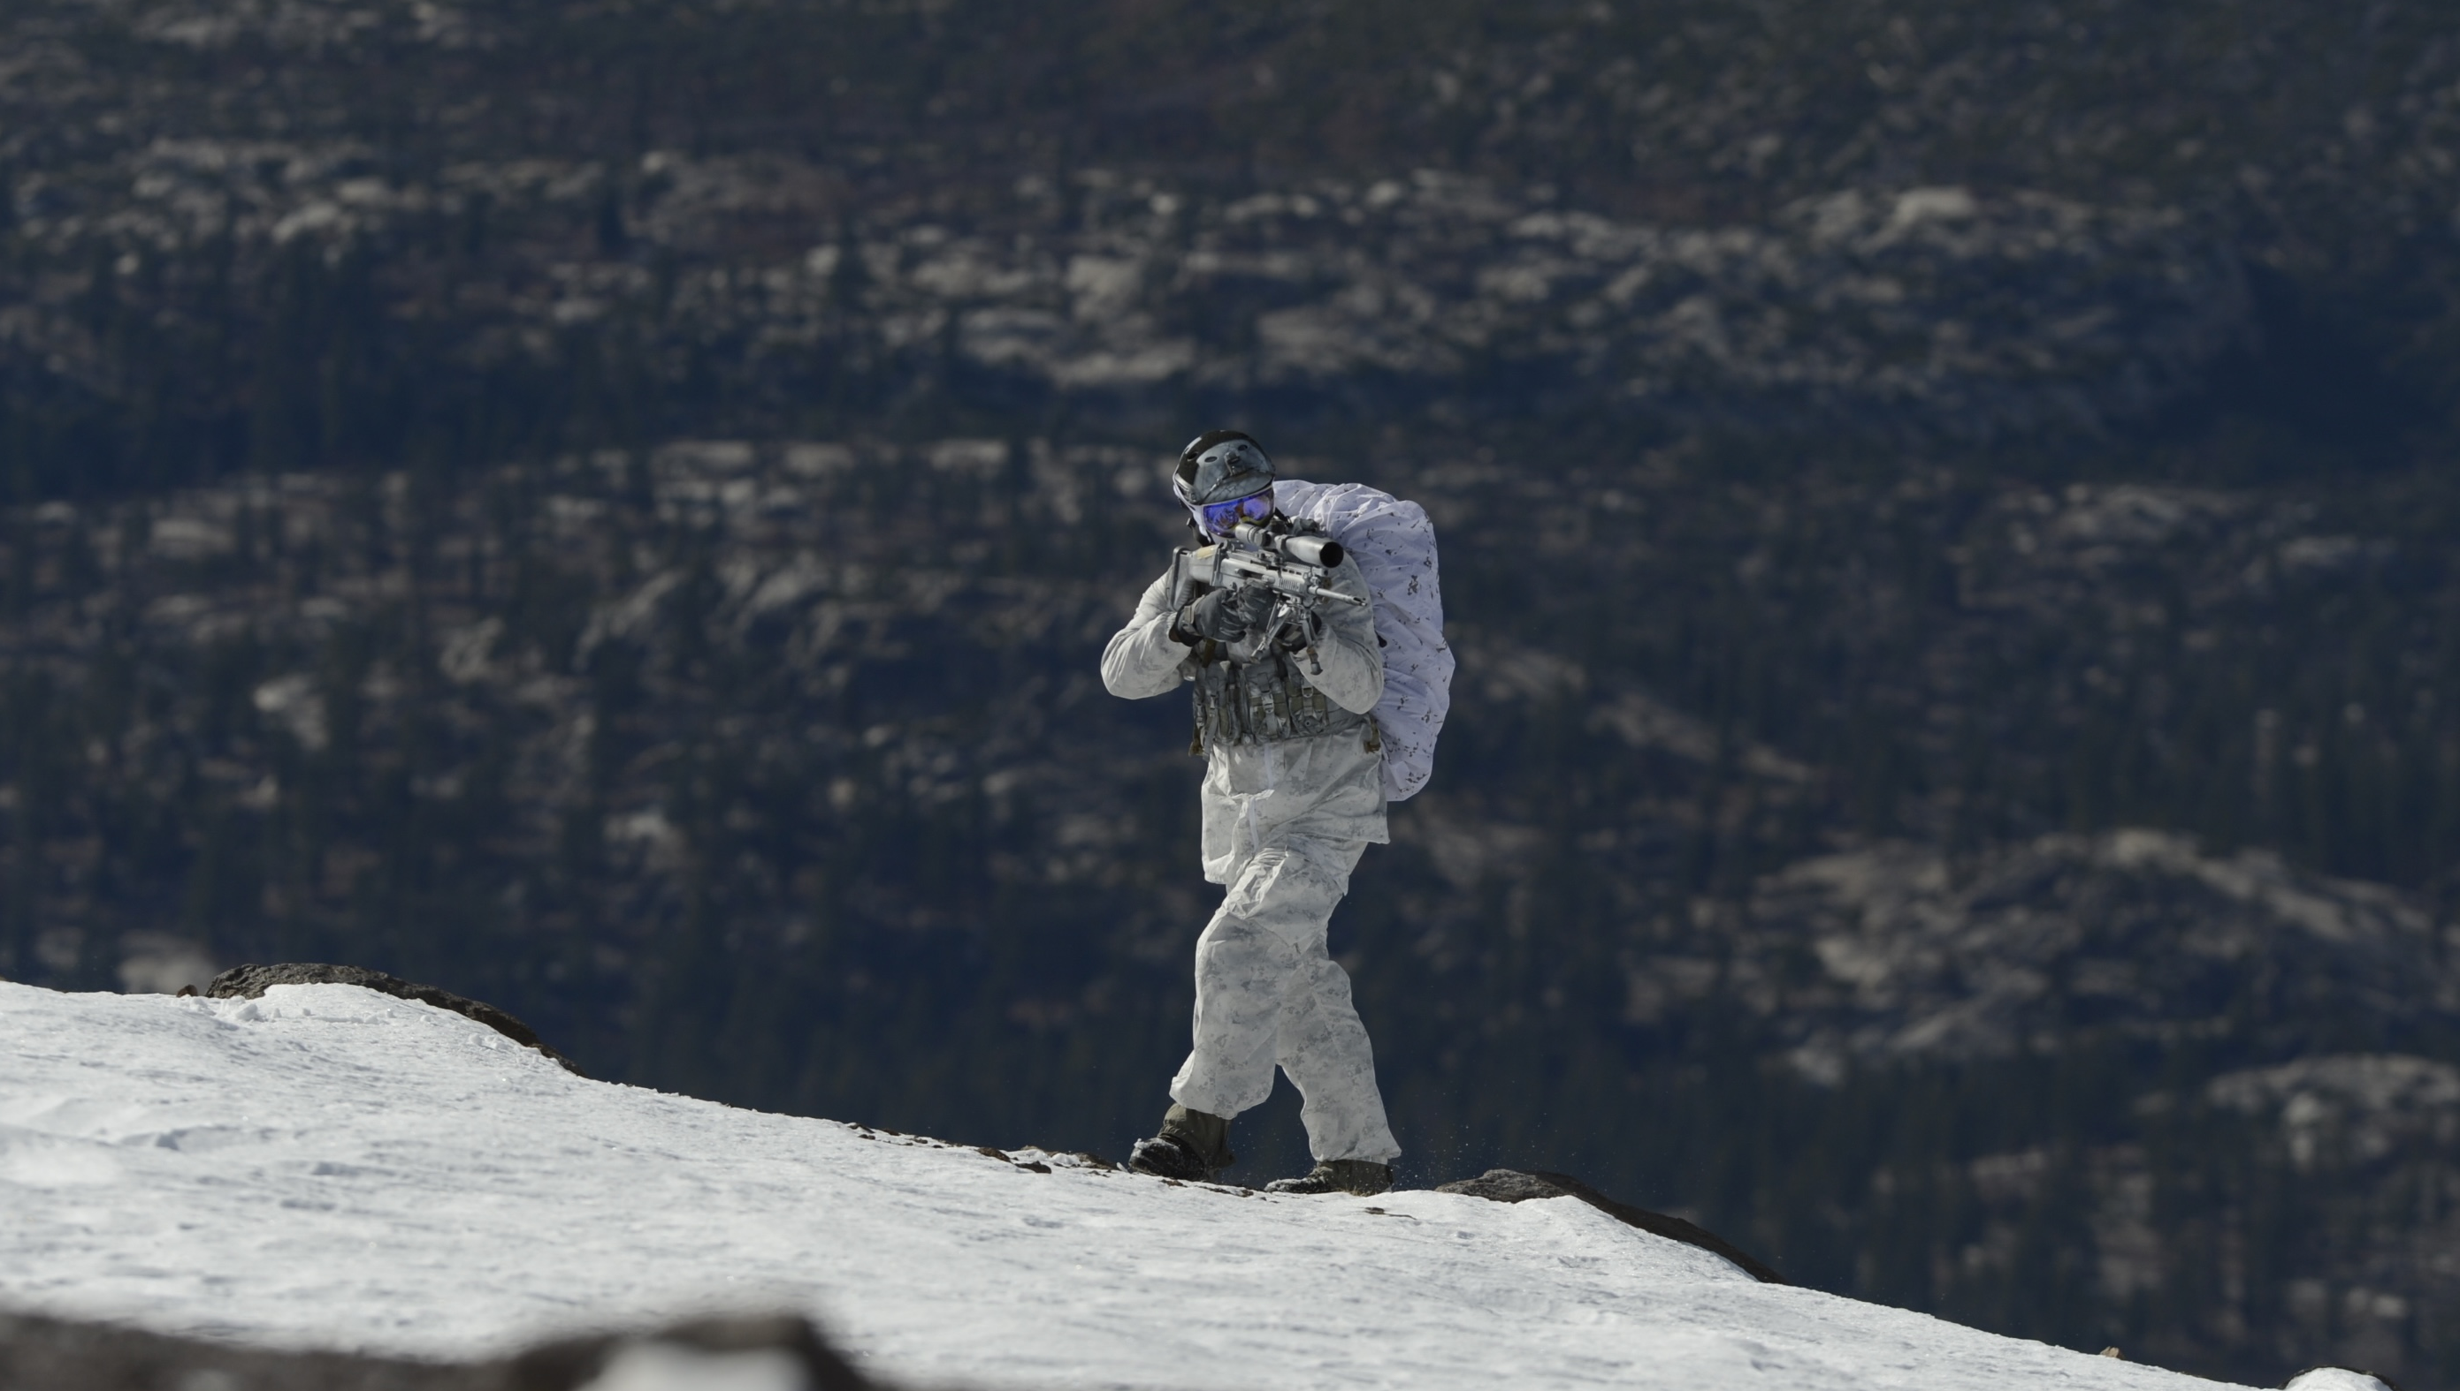
Our Capabilities
WARFIGHTING
Surface Warfare
Submarine Warfare
Air Warfare
Special Operations
(SEALs, EOD)
Notes:
MAMMOTH LAKES, CALIFORNIA, UNITED STATES
12.09.2014
Navy SEALs demonstrate winter warfare capabilities.

Slide 10
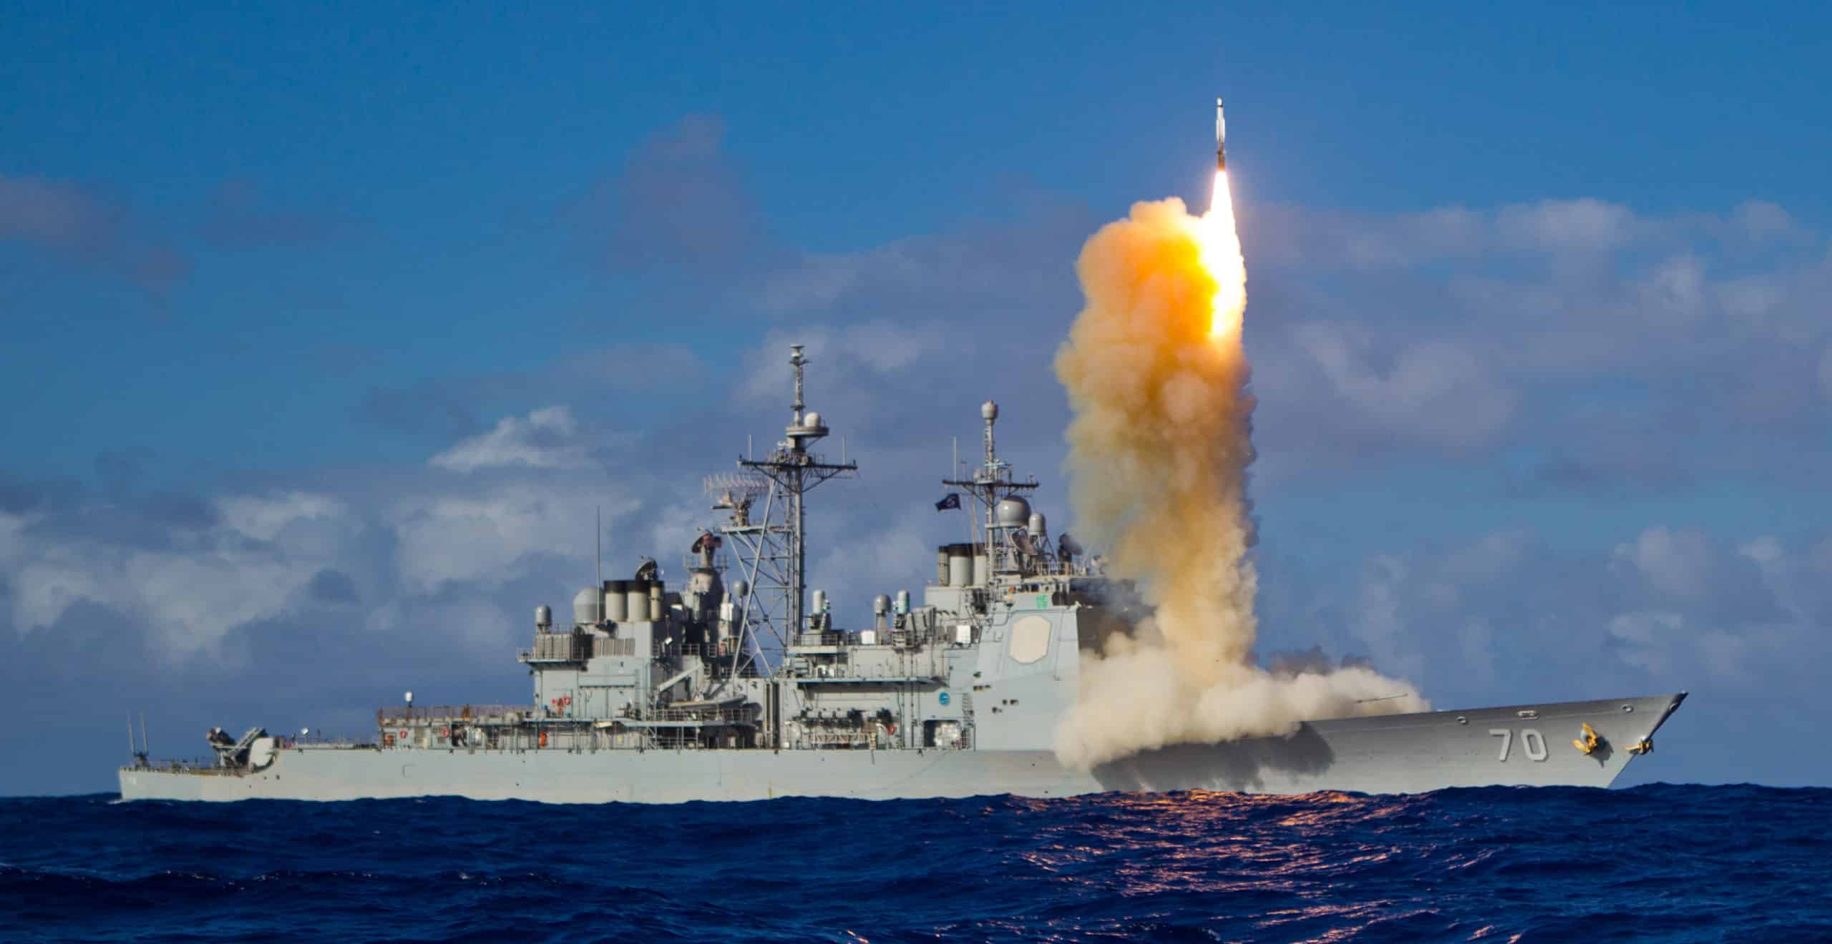
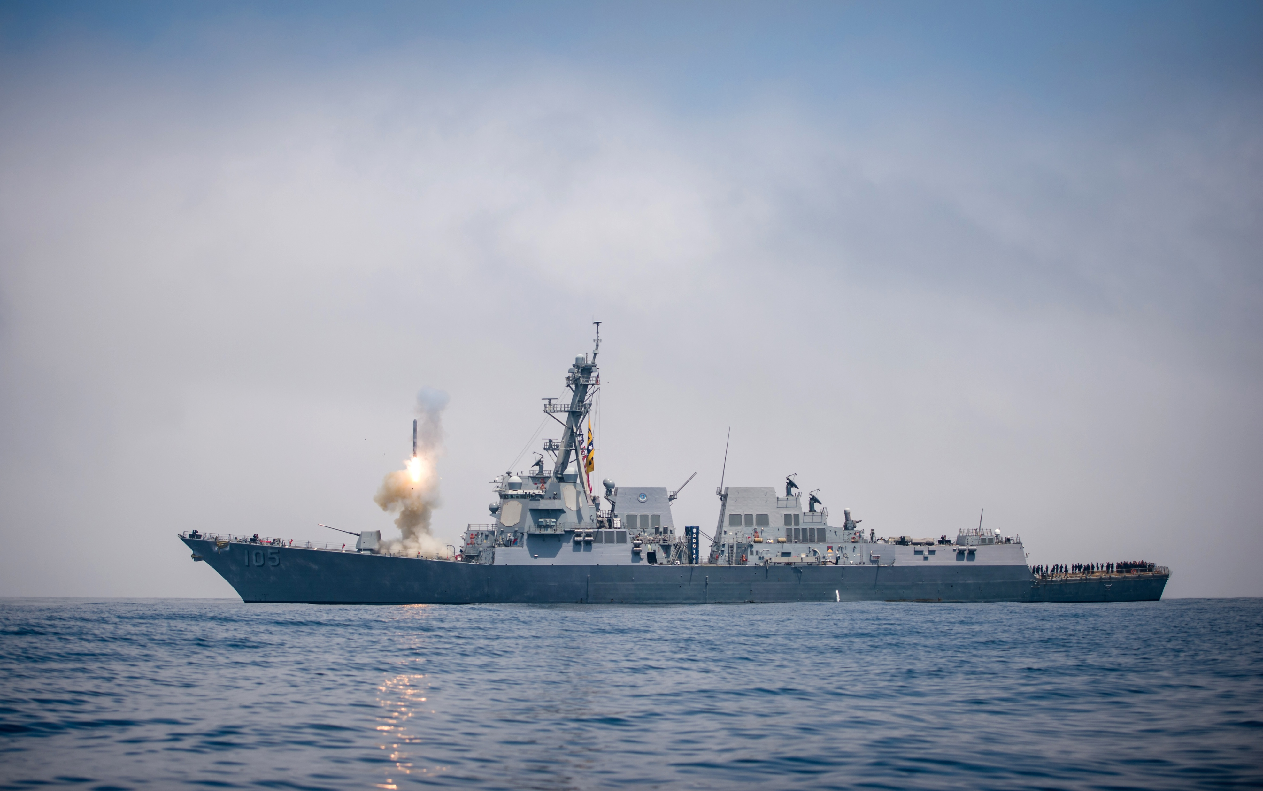
Our Capabilities
STRATEGIC & GLOBAL DEFENSE
Space
Operations
Information
Warfare
Cyber
Operations
Nuclear
Deterrence
Ballistic Missile
Defense
Expeditionary
Warfare
Notes:
180817-N-LI768-1068
PACIFIC OCEAN (August 17, 2018) The guided missile destroyer USS Dewey (DDG 105) conducts a tomahawk missile flight test while underway in the western Pacific. NAVAIR Public Release 2018-849. Distribution Statement A - “Approved for public release, distribution is unlimited.” (U.S. Navy photo by Mass Communication Specialist 2nd Class Devin M. Langer)

Slide 11
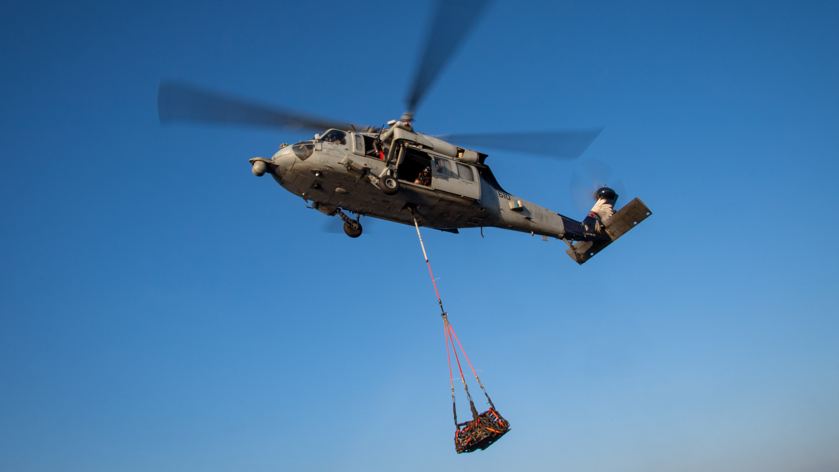
Our Capabilities
SUPPORT & SUSTAINMENT
Logistics & Sealift
Medical Support
Training & Simulation
Shore Infrastructure
Notes:
SOUTH CHINA SEA
05.03.2025
An MH-60S Sea Hawk helicopter from the “Indians” of Helicopter Combat Squadron (HSC) 6 prepares to drop supplies on the fo'c'sle of the Arleigh Burke-class guided-missile destroyer USS Gridley (DDG 101) during a vertical replenishment in the South China Sea, May 3, 2025. Gridley, assigned to the Nimitz Carrier Strike Group, is underway in the U.S. 7th Fleet area of operations on a scheduled deployment, demonstrating the U.S. Navy's unwavering commitment to a free and open Indo-Pacific. (U.S. Navy photo by Mass Communication Specialist 2nd Class Timothy Meyer)

Slide 12
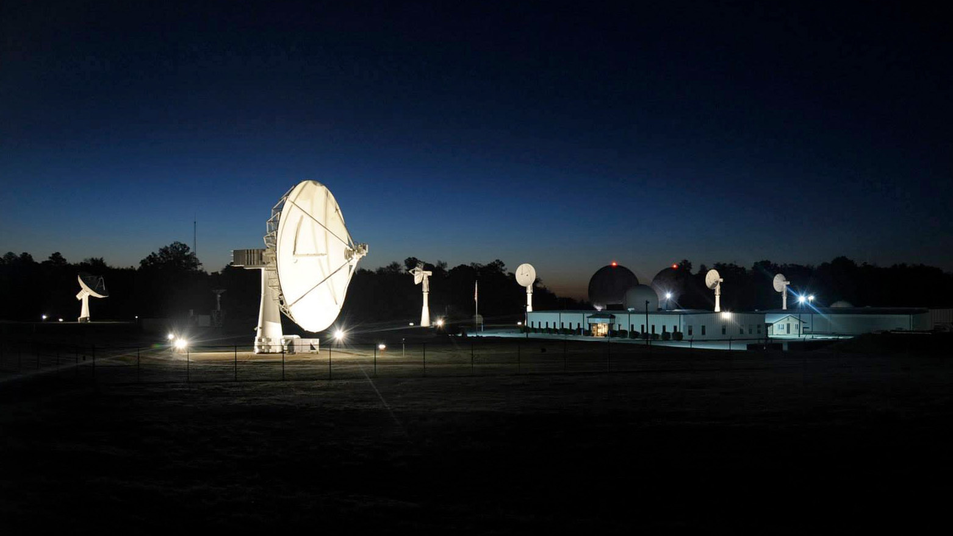
Our Capabilities
INTELLIGENCE & COMMAND
Command & Control (C2)
Legal & Governance
(JAG, NCIS)
Public Affairs & Strategic Communication
Intelligence, Surveillance, & Reconnaissance (ISR)
Notes:
BLOSSOM POINT, MARYLAND, UNITED STATES
05.11.2016
The Blossom Point Tracking Facility (BPTF) campus, located 40 miles southeast of Washington, D.C., consists of a satellite mission operations center, multiple antennas, and an existing infrastructure capable of providing space system command, control, and management for all customer classes. The facility, operated by the U.S. Naval Research Laboratory, is in continuous 24 hour, 7 day, operation and at present supports on-orbit 27 spacecraft.

Slide 13

Our Capabilities
INNOVATION & PARTNERSHIPS
Research & Development
Foreign Military Engagement
Environmental Stewardship
Humanitarian & Disaster Response
Notes:
240805-N-BB269-1073
LEGAZPI, Philippines (Aug. 5, 2024) – U.S. Navy Electronics Technician (Submarine) 3rd Class Randy Breigle, from South Amboy, N.J., high-fives a group of students during a community outreach event at the Arimbay Elementary School in support of Pacific Partnership 2024-2 in Legazpi, Philippines, Aug. 5, 2024. Now in its 20th iteration, the Pacific Partnership series is the largest annual multinational humanitarian assistance and disaster relief preparedness mission conducted in the Indo-Pacific. Pacific Partnership works collaboratively with host and partner nations to enhance regional interoperability and disaster response capabilities, increase security and stability in the region, and foster new and enduring friendships in the Indo-Pacific. (U.S. Navy photo by Chief Mass Communication Specialist Raymond D. Diaz III/Released)

Slide 14
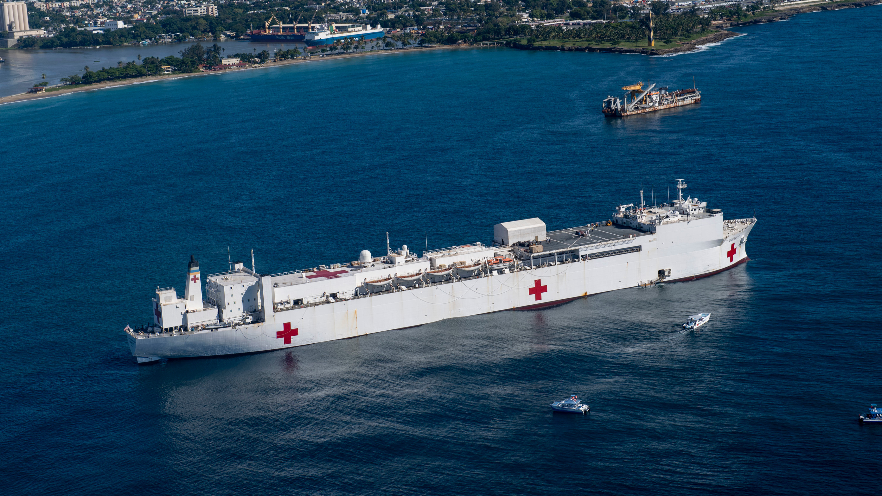
ORGANIZATION
Logo or Emblem
FULL NAME WITH NO ACRONYM
Full mission statement.
Line of Effort 1
Line of Effort 2
Line of Effort 3
Line of Effort 4
TEMPLATE TEMPLATE TEMPLATE TEMPLATE TEMPL
TEMPLATE TEMPLATE TEMPLATE TEMPLATE TEMPL
Background image specific to topic
####
Interesting statistic

Slide 15
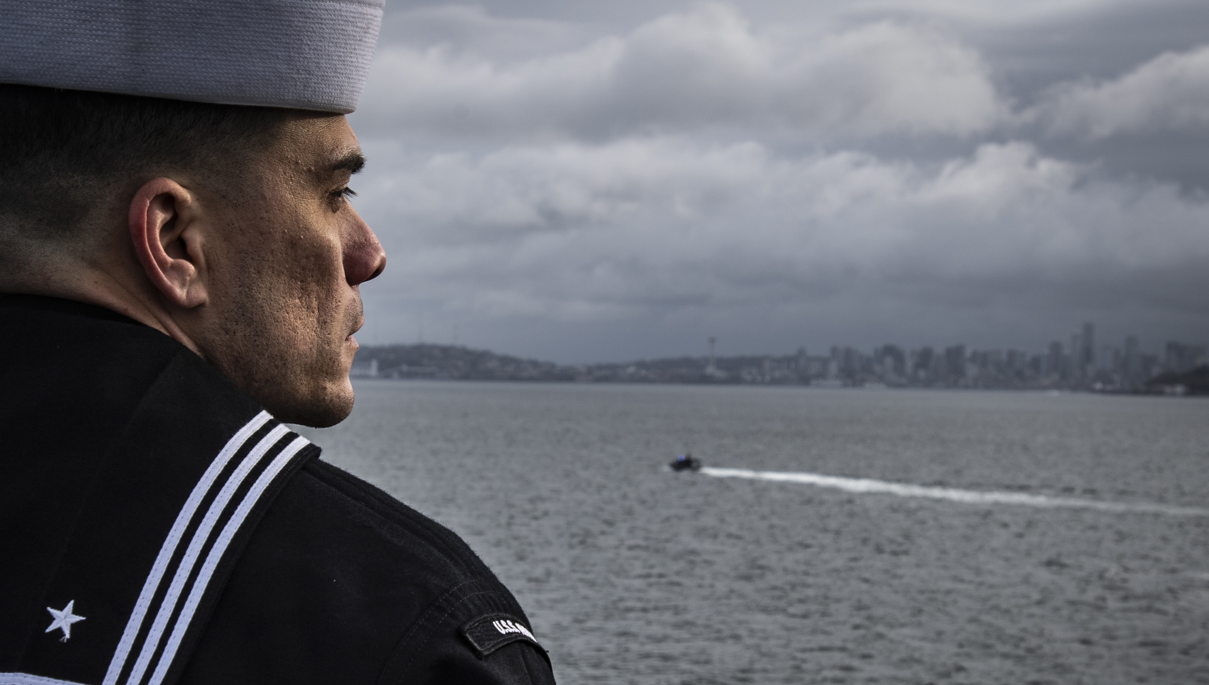


WE NEED YOU
Hire Navy Veterans
Highly trained, disciplined, and ready to lead in the civilian workforce:
https://www.dol.gov/agencies/vets/employers/hire
Encourage Service
The Navy builds skills that last a lifetime — and shape the future of our nation
https://www.navy.com/start
U.S. Navy
NAVCO
@usnavy
@USNavy
@navy.outreach
@NavyOutreach
Follow Us:
Notes:
UNITED STATES
03.20.2025
Sailors man the rails on the flight deck of the aircraft carrier USS Nimitz (CVN 68) in the Puget Sound, March 21, 2025. Nimitz is underway in U.S. 3rd Fleet conducting routine training operations. (U.S. Navy photo by Mass Communication Specialist 2nd Class Hannah Kantner)

